Slide 1
Ansor: Generating High-Performance Tensor Programs for Deep Learning
Lianmin Zheng 1, Chengfan Jia 2, Minmin Sun 2, Zhao Wu 2, Cody Hao Yu 3 , Ameer Haj-Ali 1, Yida Wang 3, Jun Yang 2, Danyang Zhuo 1,4 , Koushik Sen 1, Joseph E. Gonzalez 1, Ion Stoica 1
1 UC Berkeley, 2Alibaba Group, 3Amazon Web Services, 4 Duke University

Slide 2
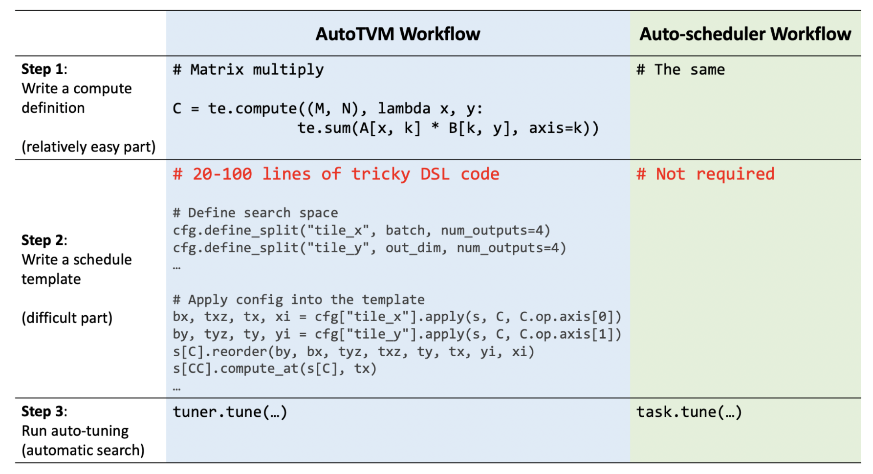
AutoTVM and Ansor workflow compare

Slide 3
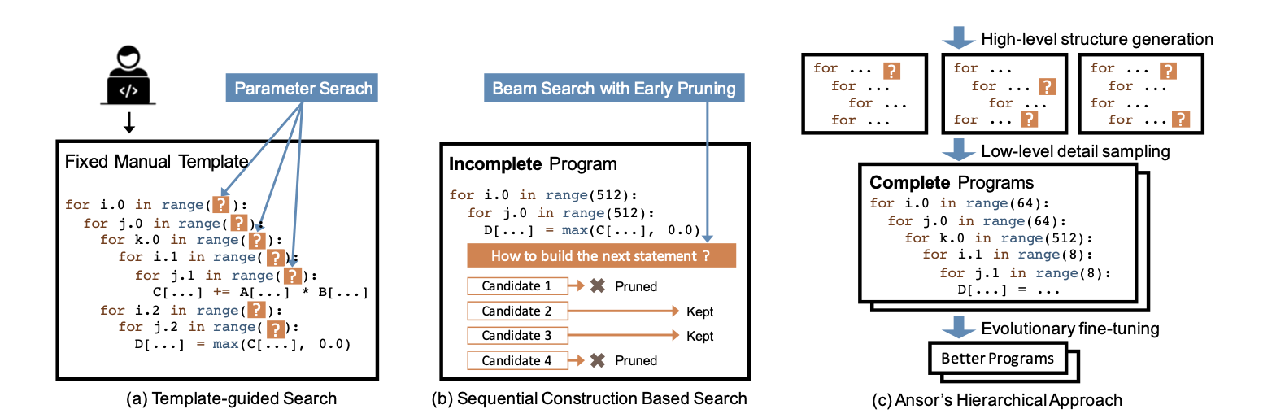
traditional TVM
Halide
Ansor
Search strategy comparison

Slide 4
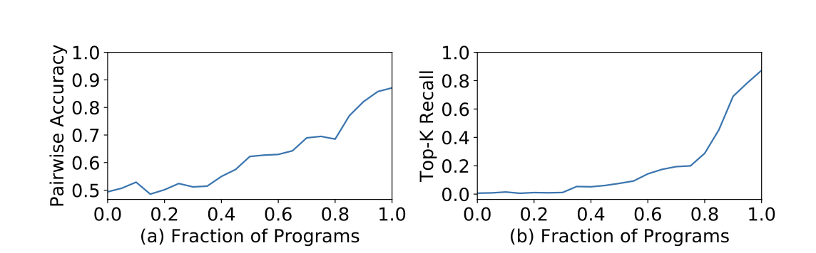
Pairwise comparison accuracy and top-k recall curve on random partial programs. In both subfigures, higher values are better.

Slide 5
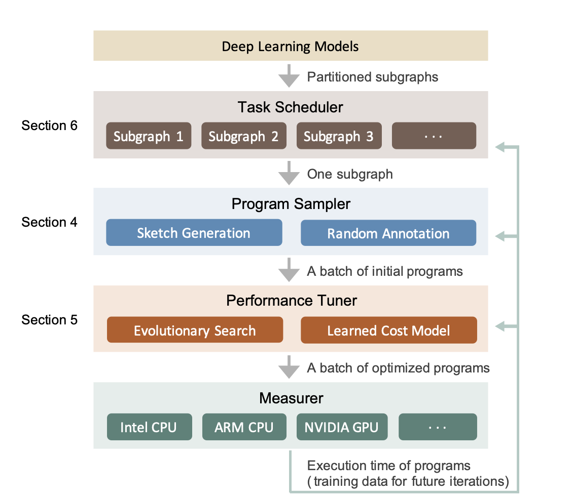
system overview

Slide 6
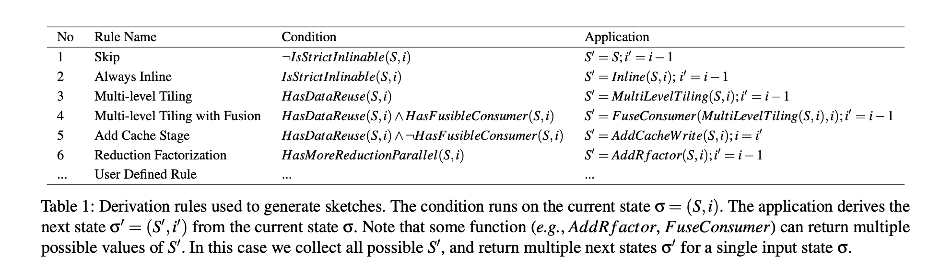
Program Sampling
sketch generation
σ = (S, i)
initial state σ = (naive program,index of the last node).
σ′ = (S′ , i′ ) where i′ ≤ i.
Notes:
The nodes in a DAG are sorted in a topological order from output to input.
For each rule, if the current state satisfies the ap- plication condition, we apply the rule to σ = (S,i) and get σ′ = (S′ , i′ ) where i′ ≤ i.
Rule 6 can use rfactor [46] to factorize a reduction loop into a space loop to bring more parallelism.

Slide 7
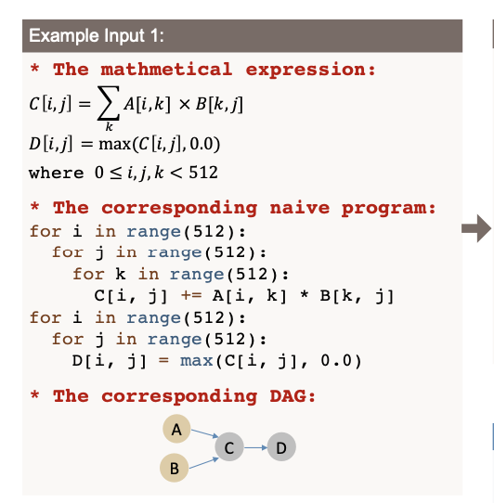
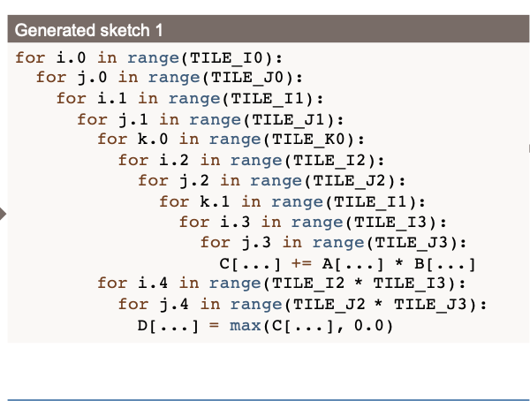
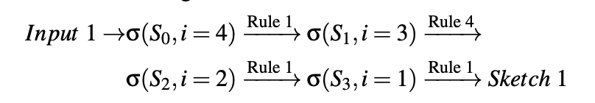
Program Sampling
sketch generation
multi-level tiling:
CPU:SSRSRS
(i, j,k) into a 10-level loop (i0, j0,i1, j1,k0,i2, j2,k1,i3, j3).
GPU:SSSRRSRS
similar with previous
Notes:
Rule 3 performs multi-level tiling for data reusable nodes. For CPU, we use a “SSRSRS” tile structure, where “S” stands for one tile level of space loops and “R” stands for one tile level of reduction loops. For example, in the matmul C(i, j) = ∑k A[i, k] × B[k, j], i and
j are space loops and k is a reduction loop.
S:space
R:reduce

Slide 8
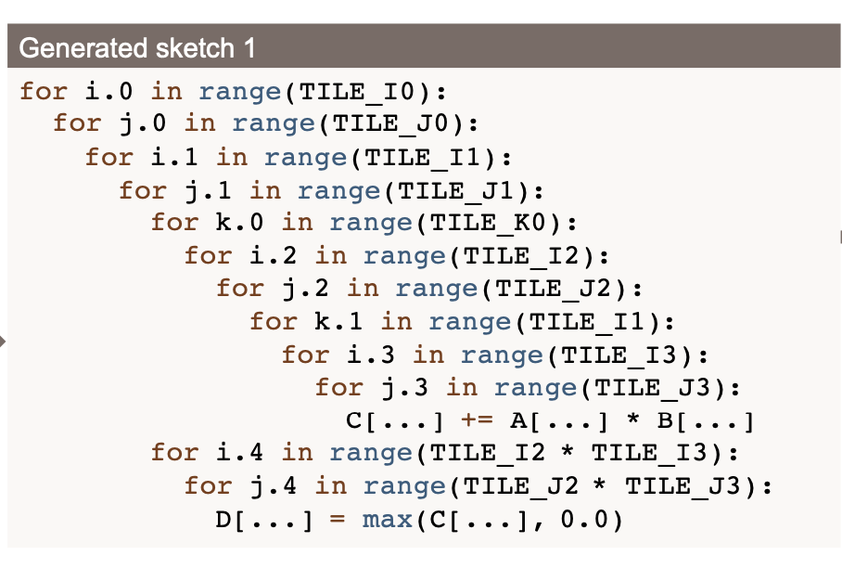
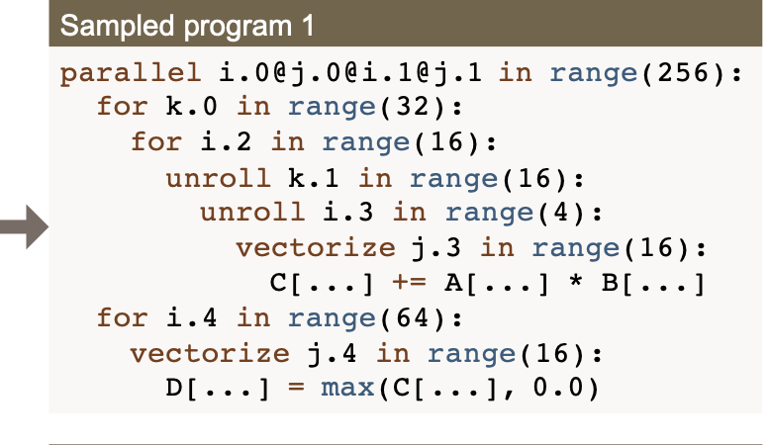
Program Sampling
random annotation
Notes:
之前产生的sketch没有指明具体的tile size，loop annotation（loop，parallel，vectorization），在有效参数中按照正态分布随机生成
允许用户自定义annotations
compiling阶段改变constant tensor的数据排布

Slide 9
Performance Fine-tuning
mutation
cross over
tile size mutation
based nodes
parallel mutation
pragma mutation
computation location mutation
Cost Model
GBDT
Notes:
性能调优：evolutionary search
learned cost model

Slide 10
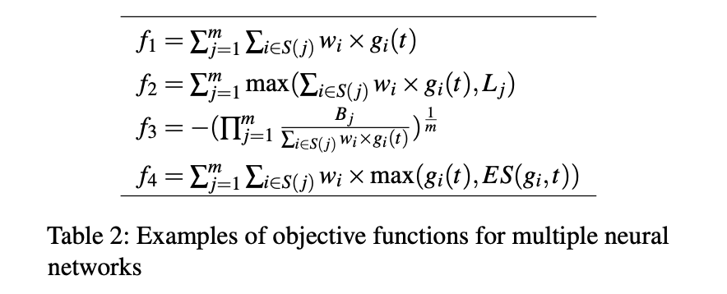
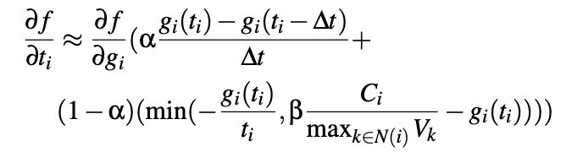
Task Scheduler

Slide 11
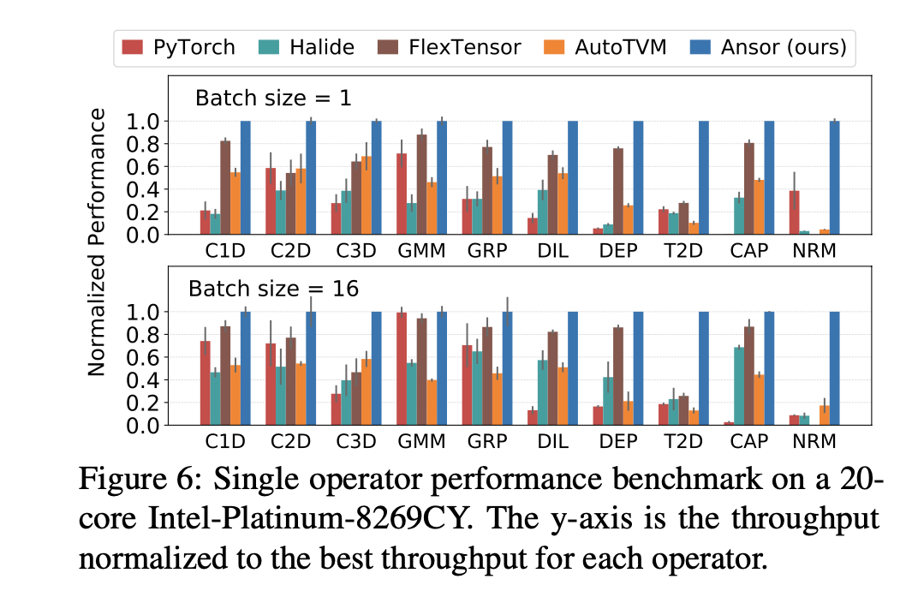
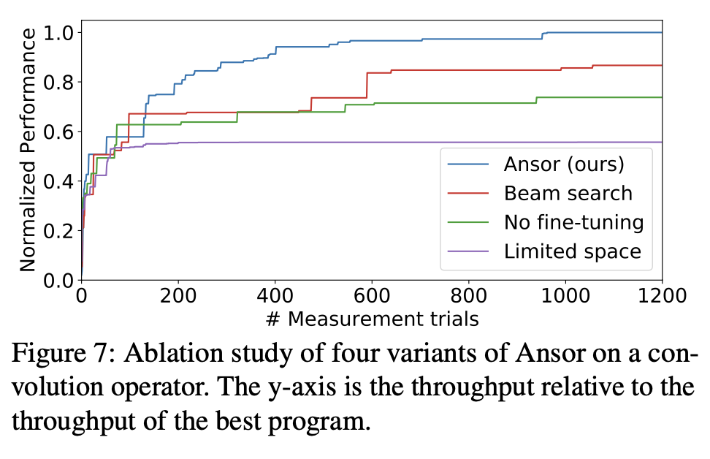
Evaluation Single Operator Benchmark
Workloads:1D, 2D, and 3D convolution,matrix multiplication etc.
Baselines:
PyTorch (v1.5)
AutoTVM
Halide auto-scheduler
FlexTensor
Notes:
Intel CPU (18-core Platinum 8124M@3.0 GHz)
NVIDIA GPU (V100)
ARM CPU (4-core Cortex-A53@1.4GHz on the Raspberry Pi 3b+)
float32

Slide 12
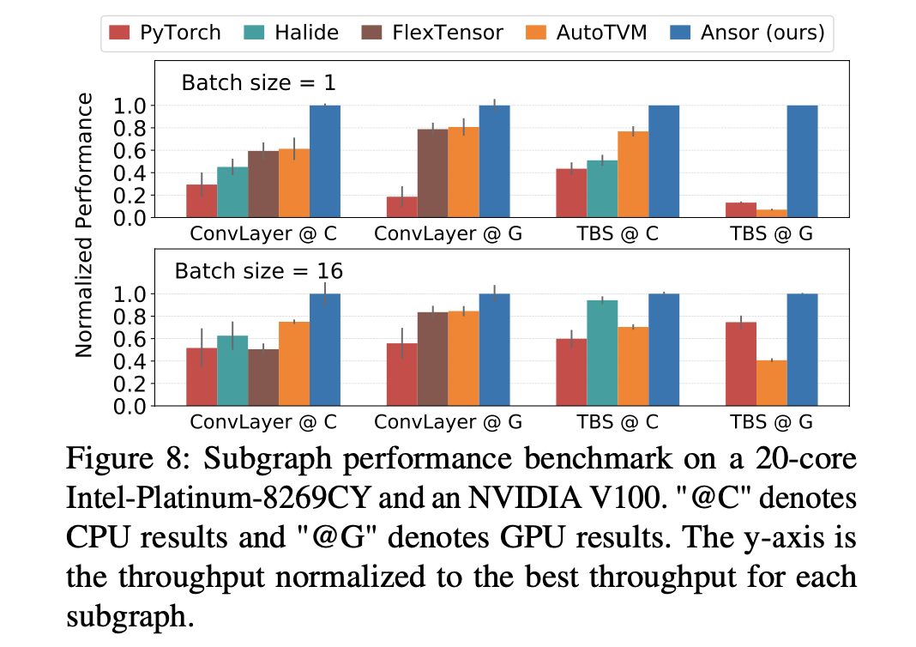
Evaluation Subgraph Benchmark

Slide 13
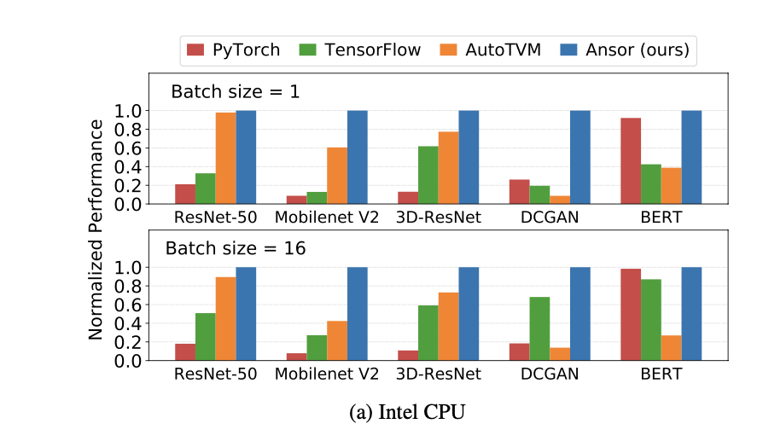
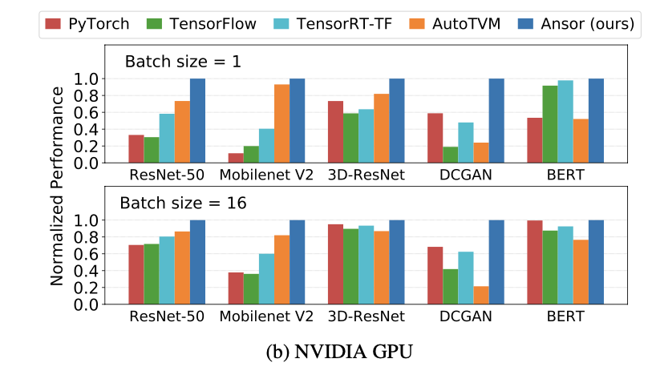
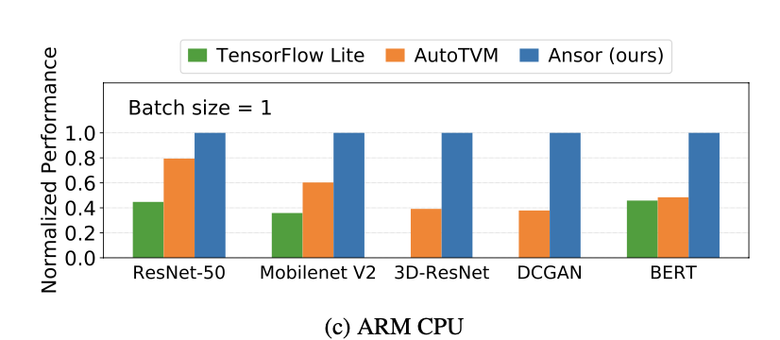
Evaluation End-to-End Network Benchmark

Slide 14
Limitations and Future work
1.Ansor cannot optimize graphs with dynamic shapes.
2.Ansor only supports dense operators.
3.Ansor only performs program optimizations at a high level but relies on other code generators
(e.g., LLVM and NVCC) to do platform-dependent optimizations (e.g., instruction selection).
Conclusion
Ansor, an automated search framework that generates high-performance tensor programs.
for deep neural networks.
large search space.
high performance and simple workflow for users.

